Slide 1




DIGITAL LITERACY
SKILLS
BASIC USERS

Slide 2
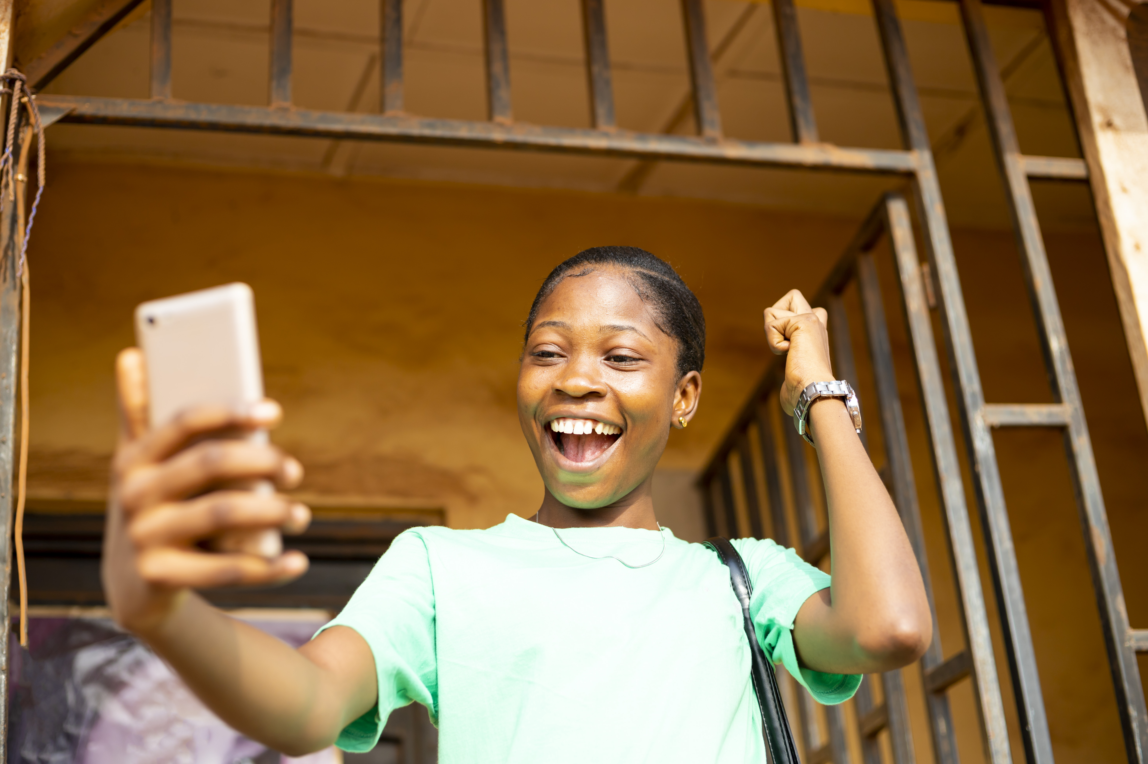
Module 4
Content

Slide 3

2
Unit 2: Integrating and
re-elaborating digital content

Slide 4
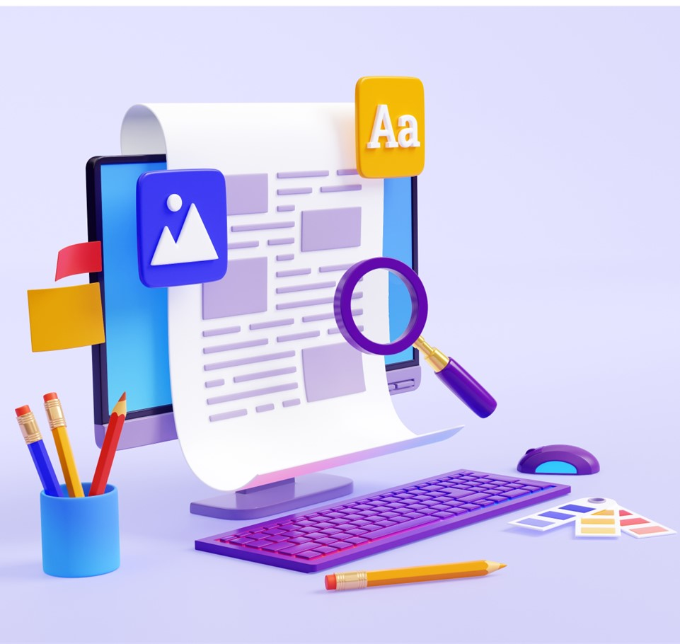
Content creation
Content creation and integration is to modify, refine and integrate new information and content into an existing content and resources to create new, original and relevant content and knowledge.
You should ask: Who am I trying to reach?
Start by carrying out research to ensure you are making the right choice.

Slide 5
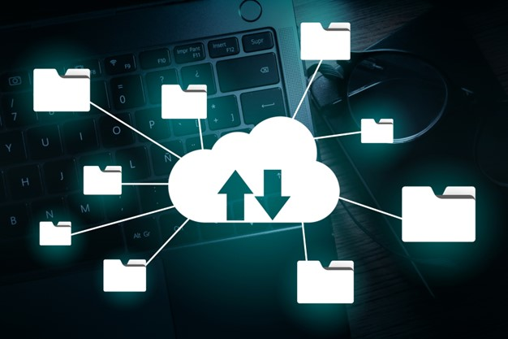
Storing your content
You should know the safest way save your content for ease of access but also security.
Cloud file sharing can be a useful platform, which allows you to access content from any device.
Discover Dropbox, Google Drive, and One Drive and change the way you share your materials.

Slide 6
Skills to practise
Edit basic content
Share your three blog posts written for the previous unit with a friend.
Receive their three posts.
Edit the three posts by checking for any spelling or punctuation errors.
Discuss the blogs with your friend and suggest any improvements that could be made to the content.

Slide 7
All back covers should include
contact information of the section
producing the work.
© United Nations Children’s Fund (UNICEF) [month and year of publication]

